Slide 1

Leadership for Advancing Whole Health: Cultivating Purpose, Skills and Impact
Mary Jo Kreitzer PhD, RN
Amy Locke, MD
Victoria Maizes, MD
Maria Mascarenhas, MBBS
Mari Ricker, MD
Ben Kligler, MD

Slide 2
Purpose & Values
Claiming a Life of Intention and Meaning
Mary Jo Kreitzer
Amy Locke

Slide 3
Outline
Why Purpose?
Exploring Gifts, Passions
and Values
Distilling your Purpose

Slide 4
Why Purpose?
Purpose is a powerful driver in our lives that may or may not
be related to our job and career.
Purpose is connected to health, wellbeing, resilience,
and happiness
Mattering (one’s sense of difference one makes in the world)
is related to psychological and organizational outcomes.

Slide 5

Adult Development
It is normal for purpose to evolve over time.
It is normal for purpose
to evolve over time.

Slide 6
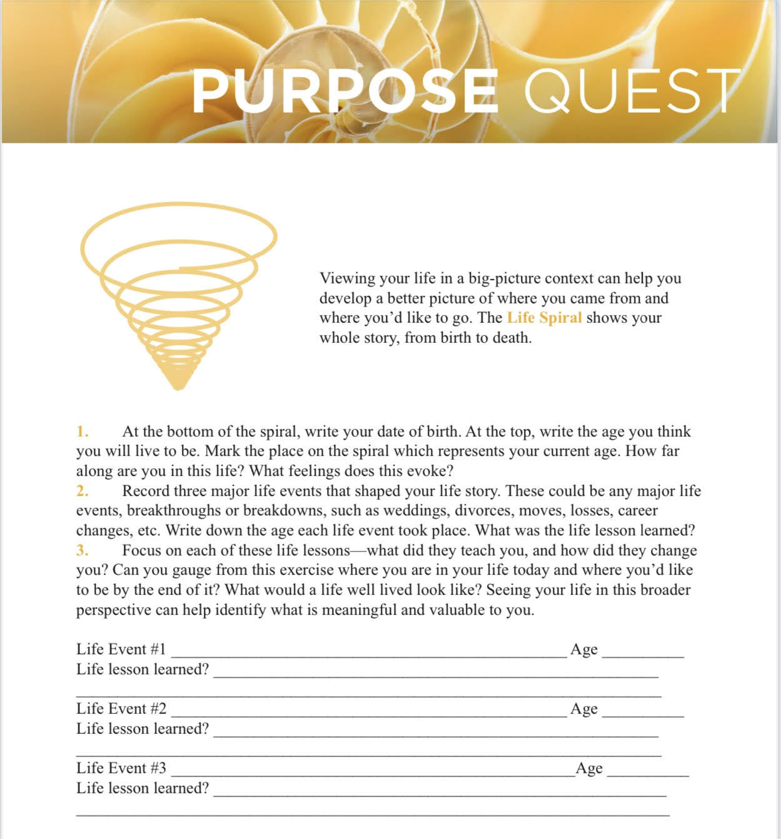
Life Spiral Exercise
.

Slide 7
Exploring your Gifts, Passions and Values

Slide 8
Gifts (Innate Strengths)
Your gifts are natural and often emerge early in life.
Skills are learned through education and practice.
Gifts show up in the things we love to do.

Slide 9
Gifts (Innate Strengths))
Spend some time journaling (later) on these questions:
What comes naturally to you?
What do others observe you doing
effortlessly and superbly?

Slide 10
Passions
What you care deeply about?
What moves you?
What inspires you?
What is worth doing?
What is it that life is asking you to fulfill?

Slide 11
Values
Values are the fundamental principles or standards that guide your behavior and decision-making.
They reflect what you consider important, and how you prioritize where you place your time and resources.

Slide 12
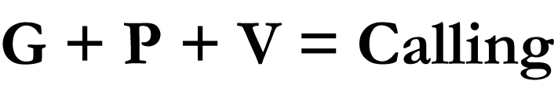
Exploring your Gifts, Passions and Values

Slide 13
Manifestation
of Purpose

Slide 14
Ways that Purpose Emerges
What you love to do.
How you like to serve.
You likely know the feeling of being lost in a task – you are
so totally absorbed and focused. That often happens when
you are doing something aligned with your purpose.

Slide 15
Crafting a Purpose Statement
A purpose statement can be a declaration as well as a guiding light.
Default Purpose Statement – How will I grow and give today?
I get up in the morning to …..

Slide 16
Creating a Sounding
Board
Interested and interesting
Listen deeply
Ask great questions
Are honest with you and will tell the truth

Slide 17
The Good Life
Living in the place you belong, with the people you love, doing the right work, on purpose!

Slide 18

Tell me what it is that you plan to do with your one wild and precious life.
~Mary Oliver

Slide 19
Leading by Values: a touchstone for troubled times
Notes:
At this time of high work and personal related stress, I find it helpful to return to the Resilience Formula and to a discussion of values.
Moral distress is particularly high. How we act can help manage this stress.

Slide 20
Resilience Formula
Leave
Status quo
Change what you can & for what you can’t change, live by values

Slide 21
Resilience Formula
Leave
Status quo
Change what you can & for what you can’t change, live by values

Slide 22

Values
Deepest desires for how you want to:
Treat yourself
Interact with others
Engage with world
Pexel

Slide 23

Values are never completed
A value is like heading West; no matter how far West you go, you never reach it.

Slide 24
Can return to values any time

Slide 25
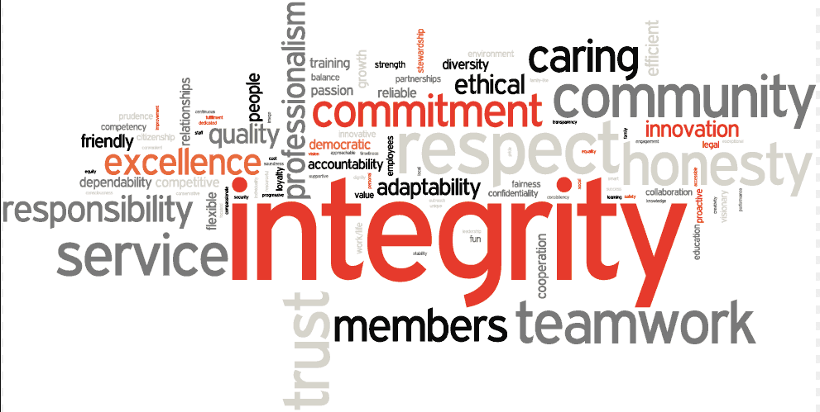
What do I/we want to stand for?
Wilson & Murrell 2004
Notes:
In the face of a challenge, if you can select a value of how you want to interact with the world, it gives you a sense of control.
Goals are not the same thing as values

Slide 26
What do I want to stand for?
Values List
Acceptance | Courage | Forgiveness | Integrity | Respect
Adventure | Creativity | Fun/ humor | Kindness | Responsibility
Caring | Curiosity | Genuineness | Knowledge | Self-care
Commitment | Engagement | Gratitude | Openness | Supportive
Connection | Friendliness | Honesty | Patience | Trust

Slide 27

If I Was acting more in accordance of the value ___________, I would…
1.
2.
3.

Slide 28
CHOICE POINT
TOWARDS
AWAY
Exercise
Quality time with family
Healthy & tasty food
Take breaks
Patient with colleagues
Flexible with change
Deep breaths when stressed
Validating experience
Creative
Caught up in anxiety
Too much news/social media
Distracted by thoughts/email
Staying up too late
Stress eating
Reactive, irritable, impatient
Avoiding exercise
Avoiding people

Slide 29
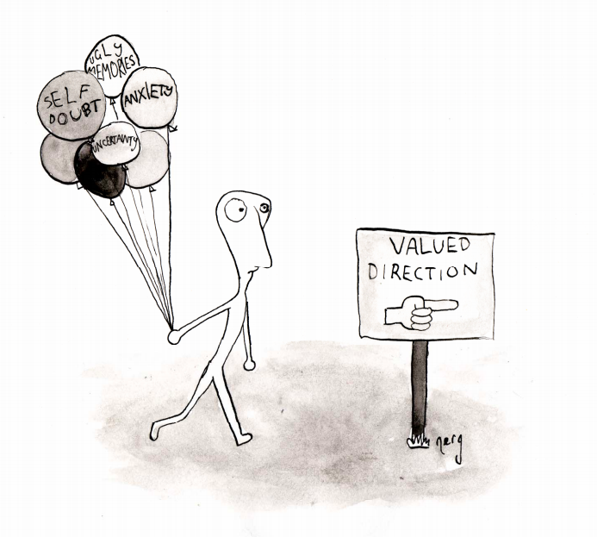
Ciarrochi

Slide 30
Values Sort
Notes:
Values sort exercise
What values are most important to you in the work setting? Focus on next step of your career.
Pair-Share model
Compare values that are most important to you? What do you notice as you see what is the same and different?
What opportunities do you have to live in accordance with these values right now?
What gets in the way?
Values sort: each participant uses a values card sort exercise to reflect on what values are most important to them in the next stage of their career. Then spend time focused on what next steps would be in accordance with those values.
Think Pair Share: Does how you currently spend your time match these values?
How does this exercise impact how you might spend your time differently than you currently do?
What else came up as a result of this exercise?

Slide 31
Discussion
Share your highest priority values. What patterns do you see?
What opportunities do you have to live in accordance with these values right now?
What gets in the way?

Slide 32
Career Reflection
Imagine you are at the end of your career and looking back.
What do you hope to have accomplished? Why is that important to you? How does that match the values you identified from the values card sort? What do you need to do now in order to continue on the path towards that future?
Notes:
Think pair share

Slide 33


Leadership Skills
Victoria Maizes MD
Founding Executive Director, Andrew Weil Center for Integrative Medicine
Professor of Medicine, Family Medicine, and Public Health,
University of Arizona
Maria Mascarenhas MBBS
Medical Director, Integrative Health Program, Children’s Hospital of Philadelphia
Professor of Pediatrics, Perelman School of Medicine,
University of Pennsylvania

Slide 34
What we will cover today….
Leadership skills including a self-assessment, strategy, barriers and opportunities, effective communication, and negotiation unique to integrative health initiatives
Notes:
Intro -1 minutes
Movement -3 minutes
Self-assessment activity re current skill level – 3 minutes
VM and MM discussion re strategy including personal examples - 4 minutes
Group discussion re barriers and opportunities – 7 minutes
Effective communication – discussion – 3 minutes
Strategy/Communication activity 15 minutes
Financial literacy discussion – 10 minutes
?Negotiation skills

Slide 35


Movement Break
Notes:
MRM will do: stretches
VM will do humming, box breath, 4-7-8, and cyclic sighing.

Slide 36

Let’s take a pulse check as to where we are right now…
Self-Assessment Activity
Notes:
Self-assessment activity re current skill level
3 minutes

Slide 37
Strategy and Goal Setting
What are the barriers you face at your institution?
What is possible?
What are the opportunities?
Notes:
Introduction: VM and MM discussion re strategy including personal examples and invite audicne to share as well - 4 minutes
Reinforce the need for mentorship and creating a village Woven into looking at landscape and pulling team together. Creating institutional support. External support. (Integrative GI nationally.) (consortium meeting)

Slide 38
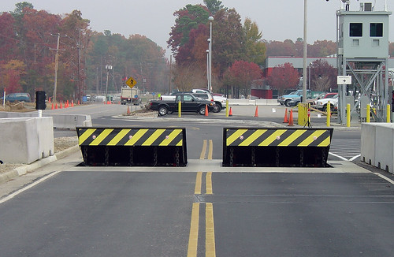

Strategy and Goal Setting
Set attainable programmatic goals and develop strategies
  Align with institutional strategy and priorities
  Move from passion project to win-win
  Know how changes happen at your institution
  Invites to table for effective program development
  Create your team (village)? Members with varied strengths to complement you.
  Find and work with mentor(s)?
  Create institutional support: local, external
What first 3 steps can you take? Group discussion
This Photo by Unknown Author is licensed under CC BY-NC-ND
This Photo by Unknown Author is licensed under CC BY-SA
Notes:
Introduction: VM and MM discussion re strategy including personal examples - 4 minutes
Reinforce the need for mentorship and creating a village Woven into looking at landscape and pulling team together. Creating institutional support. External support. (Integrative GI nationally.) (consortium meeting)
V

Slide 39

Effective Communication
Be clear and concise
Be prepared
Be mindful of nonverbal communication and tone
Practice active listening
Build your emotional intelligence
Develop a workplace communication strategy
Create a positive organizational culture
Notes:
2 minutes
8 Ways You Can Improve Your Communication Skills - Professional & Executive Development | Harvard DCE
1. Be clear and concise
Communication is primarily about word choice. And when it comes to word choice, less is more.
The key to powerful and persuasive communication — whether written or spoken — is clarity and, when possible, brevity.
Before engaging in any form of communication, define your goals and your audience.
Outlining carefully and explicitly what you want to convey and why will help ensure that you include all necessary information. It will also help you eliminate irrelevant details.
Avoid unnecessary words and overly flowery language, which can distract from your message.
And while repetition may be necessary in some cases, be sure to use it carefully and sparingly. Repeating your message can ensure that your audience receives it, but too much repetition can cause them to tune you out entirely.
2. Prepare ahead of time
Know what you are going to say and how you are going to say before you begin any type of communication.
However, being prepared means more than just practicing a presentation.
Preparation also involves thinking about the entirety of the communication, from start to finish. Research the information you may need to support your message. Consider how you will respond to questions and criticisms. Try to anticipate the unexpected.
Before a performance review, for instance, prepare a list of concrete examples of your employee’s behavior to support your evaluation.
Before engaging in a salary or promotion negotiation, know exactly what you want. Be ready to discuss ranges and potential compromises; know what you are willing to accept and what you aren’t. And have on hand specific details to support your case, such as relevant salaries for your position and your location (but be sure that your research is based on publicly available information, not company gossip or anecdotal evidence).
Before entering into any conversation, brainstorm potential questions, requests for additional information or clarification, and disagreements so you are ready to address them calmly and clearly.
3. Be mindful of nonverbal communication
Our facial expressions, gestures, and body language can, and often do, say more than our words.
Nonverbal cues can have between 65 and 93 percent more impact than the spoken word. And we are more likely to believe the nonverbal signals over spoken words if the two are in disagreement.
Leaders must be especially adept at reading nonverbal cues.
Employees who may be unwilling to voice disagreements or concerns, for instance, may show their discomfort through crossed arms or an unwillingness to make eye contact. If you are aware of others’ body language, you may be able to adjust your communication tactics appropriately.
At the same time, leaders must also be able to control their own nonverbal communications.
Your nonverbal cues must, at all times, support your message. At best, conflicting verbal and nonverbal communication can cause confusion. At worst, it can undermine your message and your team’s confidence in you, your organization, and even in themselves.
4. Watch your tone
How you say something can be just as important as what you say. As with other nonverbal cues, your tone can add power and emphasis to your message, or it can undermine it entirely.
Tone can be an especially important factor in workplace disagreements and conflict. A well-chosen word with a positive connotation creates good will and trust. A poorly chosen word with unclear or negative connotations can quickly lead to misunderstanding.
When speaking, tone includes volume, projection, and intonation as well as word choice. In real time, it can be challenging to control tone to ensure that it matches your intent. But being mindful of your tone will enable you to alter it appropriately if a communication seems to be going in the wrong direction.
Tone can be easier to control when writing. Be sure to read your communication once, even twice, while thinking about tone as well as message. You may even want to read it out loud or ask a trusted colleague to read it over, if doing so does not breach confidentiality.
And when engaging in a heated dialogue over email or other written medium, don’t be too hasty in your replies.
If at all possible, write out your response but then wait for a day or two to send it. In many cases, re-reading your message after your emotions have cooled allows you to moderate your tone in a way that is less likely to escalate the conflict.
Browse our Communication programs.
5. Practice active listening
Communication nearly always involves two or more individuals.
Therefore, listening is just as important as speaking when it comes to communicating successfully. But listening can be more challenging than we realize.
In her blog post Mastering the Basics of Communication, communication expert Marjorie North notes that we only hear about half of what the other person says during any given conversation.
The goal of active listening is to ensure that you hear not just the words the person is saying, but the entire message. Some tips for active listening include:
Giving the speaker your full and undivided attention
Clearing your mind of distractions, judgements, and counter-arguments.
Avoiding the temptation to interrupt with your own thoughts.
Showing open, positive body language to keep your mind focused and to show the speaker that you are really listening
Rephrase or paraphrase what you’ve heard when making your reply
Ask open ended questions designed to elicit additional information
6. Build your emotional intelligence
Communication is built upon a foundation of emotional intelligence. Simply put, you cannot communicate effectively with others until you can assess and understand your own feelings.
“If you’re aware of your own emotions and the behaviors they trigger, you can begin to manage these emotions and behaviors,” says Margaret Andrews in her post, How to Improve Your Emotional Intelligence.
Leaders with a high level of emotional intelligence will naturally find it easier to engage in active listening, maintain appropriate tone, and use positive body language, for example.
Understanding and managing your own emotions is only part of emotional intelligence. The other part — equally important for effective communication — is empathy for others.
Empathizing with an employee can, for example, make a difficult conversation easier.
You may still have to deliver bad news, but (actively) listening to their perspective and showing that you understand their feelings can go a long way toward smoothing hurt feelings or avoiding misunderstandings.
7. Develop a workplace communication strategy
Today’s workplace is a constant flow of information across a wide variety of formats. Every single communication must be understood in the context of that larger flow of information.
Even the most effective communicator may find it difficult to get their message across without a workplace communication strategy.
A communication strategy is the framework within which your business conveys and receives information. It can — and should — outline how and what you communicate to customers and clients, stakeholders, and managers and employees.
Starting most broadly, your strategy should incorporate who gets what message and when. This ensures that everyone receives the correct information at the right time.
It can be as detailed as how you communicate, including defining the type of tools you use for which information. For example, you may define when it’s appropriate to use a group chat for the entire team or organization or when a meeting should have been summarized in an email instead.
Creating basic guidelines like this can streamline the flow of information. It will help ensure that everyone gets the details they need and that important knowledge isn’t overwhelmed by extraneous minutia.
8. Create a positive organizational culture
The corporate culture in which you are communicating also plays a vital role in effective communication.
In a positive work environment — one founded on transparency, trust, empathy, and open dialogue — communication in general will be easier and more effective.
Employees will be more receptive to hearing their manager’s message if they trust that manager. And managers will find it easier to create buy-in and even offer constructive criticism if they encourage their employees to speak up, offer suggestions, and even offer constructive criticisms of their own.
“The most dangerous organization is a silent one,” says Lorne Rubis in a blog post, Six Tips for Building a Better Workplace Culture. Communication, in both directions, can only be effective in a culture that is built on trust and a foundation of psychological safety.
Authoritative managers who refuse to share information, aren’t open to suggestions, and refuse to admit mistakes and accept criticism are likely to find their suggestions and criticisms met with defensiveness or even ignored altogether.
Without that foundation of trust and transparency, even the smallest communication can be misconstrued and lead to misunderstandings and unnecessary conflict.
Communicating with co-workers and employees is always going to present challenges. There will always be misunderstandings and miscommunications that must be resolved and unfortunately, corporate messages aren’t always what we want to hear, especially during difficult times.
But building and mastering effective communication skills will make your job easier as a leader, even during difficult conversations. Taking the time to build these skills will certainly be time well-spent.

Slide 40

Effective Strategy/Communication Exercise
This Photo by Unknown Author is licensed under CC BY-NC-ND
Notes:
Effective communication – discussion – 3 minutes
Use handout – ask participants to quickly draft a project they wish to do. If possible, download institutional strategic plan. 5 minutes to draft. 1-2 minute to present; 1 minute feedback; then switch.
Present in pairs or threesomes

Slide 41

Financial Literacy
  Program development
    Understanding budgets
      salary/benefits, cash flow
      business office; data and analysis
    Fundraising
      Philanthropy: development and marketing
      Grants: education, prog development, innovation etc.
  Grant proposal writing/management
    Indirects – NIH/foundation/others
    Looping in research business managers
    Collaboration with other depts; sharing indirects
    Gaps in grant funding
      No cost extension
      Negotiation with division chief (discretionary funds)
      Reduce FTE
      Increase clinical effort
Notes:
Financial literacy discussion – 10 minutes

Slide 42
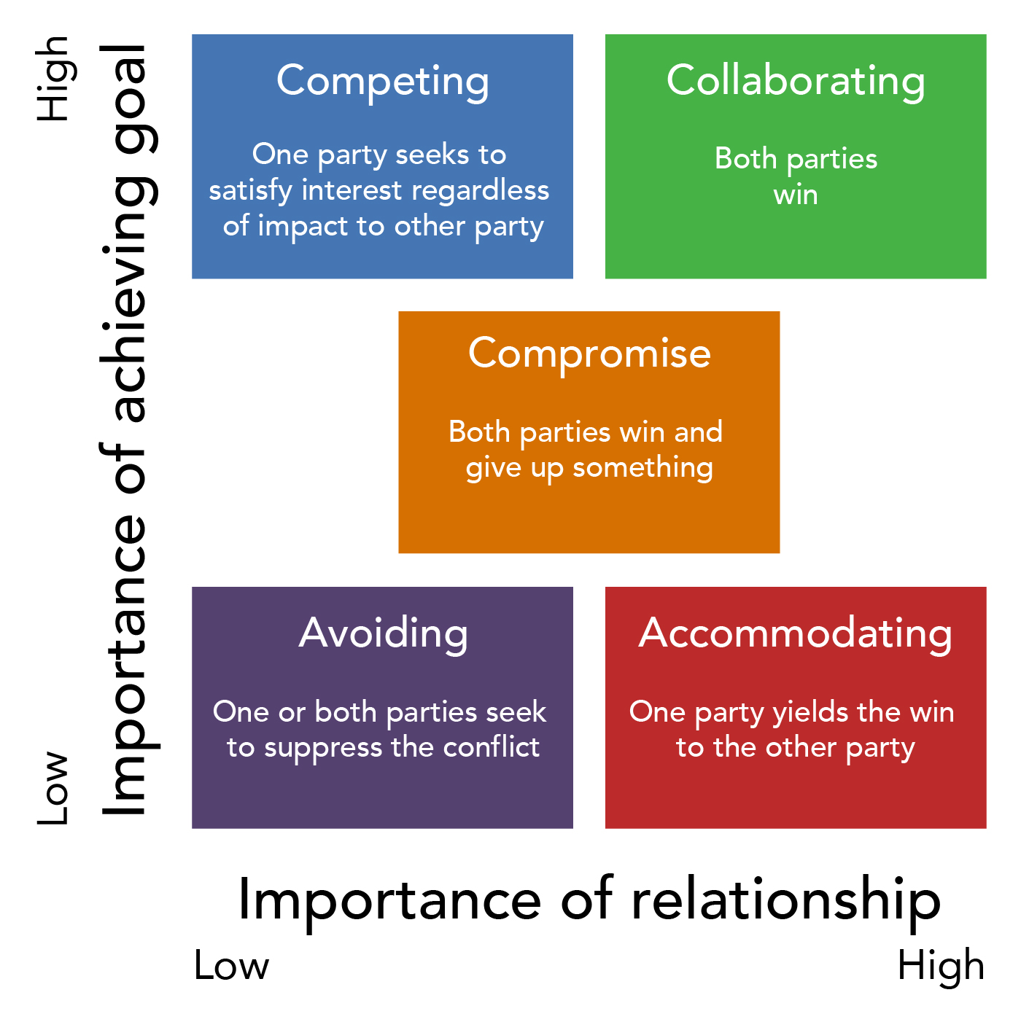
Negotiators and Negotiation Skills
Effective communication to express intentions clearly and establish boundaries
Active listening
Emotional intelligence – understand and manage emotions
Set realistic expectations
Remain calm and patient
Be flexible and open to different approaches
Prepare for successful negotiations
This Photo by Unknown Author is licensed under CC BY

Slide 43

Thank You

Slide 44

Mentoring and Conscious Leadership
Mari Ricker MD
Ben Kligler MD

Slide 45

Why do we need mentorship?
Develop professional academic skills
Career management
Knowledge
Networking
Increase in career satisfaction – professional fullfillment
Navigating professional environment
INCREASED SELF-EFFICACY
Notes:
Self efficacy – innate belief in one’s ability to accomplish goals and tasks, to meet challenges, to succeed
self esteem is “being”; self-efficacy is “doing”

Slide 46
Different ROLES
MENTEE
MENTOR
COACH
SPONSOR
ROLE MODEL
ADVOCATE
Notes:
MENTOR: Career, professional development
COACH: Specific task or skill, Performance-driven
SPONSOR: Networks, specific opportunities, Career advancement-driven, Holds a position of power and influence

Slide 47

Mentorship creates success
3 KEY LEVERS OF CAREER SUCCESS:
ABILITY
MOTIVATION
OPPORTUNITY
Ramaswami, A., Dreher, G. F., Bretz, R., & Wiethoff, C. (2010). Gender, mentoring, and career success: The importance of organizational context. Personnel Psychology, 63(2), 385-405.
Notes:
Ramaswami, A., Dreher, G. F., Bretz, R., & Wiethoff, C. (2010). Gender, mentoring, and career success: The importance of organizational context. Personnel Psychology, 63(2), 385-405.

Slide 48

Peer Mentoring
  Fills a gap not covered by a traditional mentor
  Less traditional views of position, status, power, and hierarchy
  Peers are more readily available and accessible
Murrell, A. J., Blake-Beard, S., & Porter Jr, D. M. (2021). The importance of peer mentoring, identity work and holding environments: A study of African American leadership development. International Journal of Environmental Research and Public Health, 18(9), 4920.

Slide 49

Peer Mentorship Benefits
Non-hierarchical
Empowerment
Reduced feeling of isolation
Sense of community
Self-direction
Mutual learning
Collaborative
Shared generational values
Networking
Normalize and legitimize concerns
Professional identity formation
Pooled resources
Notes:
Share: 3:25 – 3:30

Slide 50

Creating a Mentorship Mosaic
Professional Development
Publishing
Teaching
Service
Research
Networking
Work-life integration
Emotional support
Sponsorship

Slide 51
Mapping activity

Slide 52

Gaps in mentoring
  What are gaps in your own personal mentorship?
  What is the impact of this gap?

Slide 53
CONSCIOUS LEADERSHIP

Slide 54


Which way of approaching a situation is typically more effective?

Slide 55
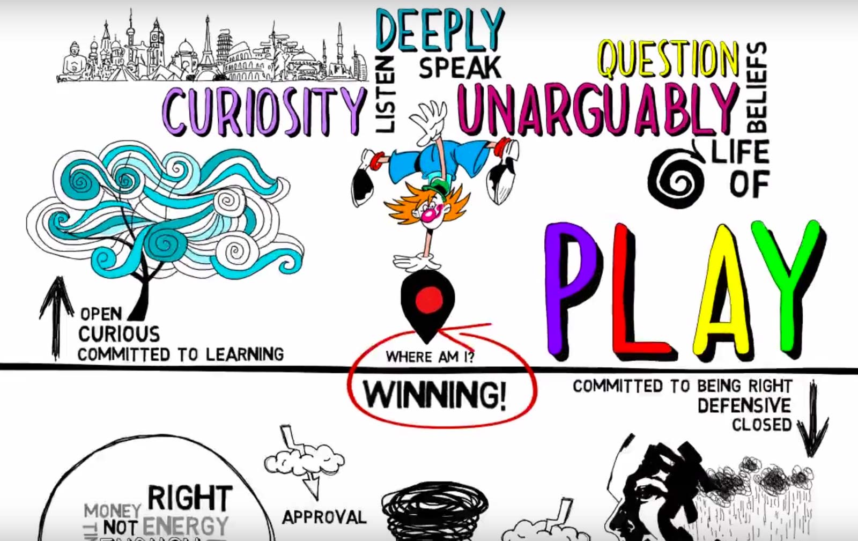
https://conscious.is/video/locating-yourself-a-key-to-conscious-leadership

Slide 56

Above the line?
Take a pause and think about what percent of time have you been above/below line over the past week
Breakout sessions groups of 3 for 5 minutes: Identify a recent situation--could be at work or home--when you were above the line.
  How did that feel?
  Why were you above the line for this one?
  Now how about one where you were below the line?
  Why?

Slide 57
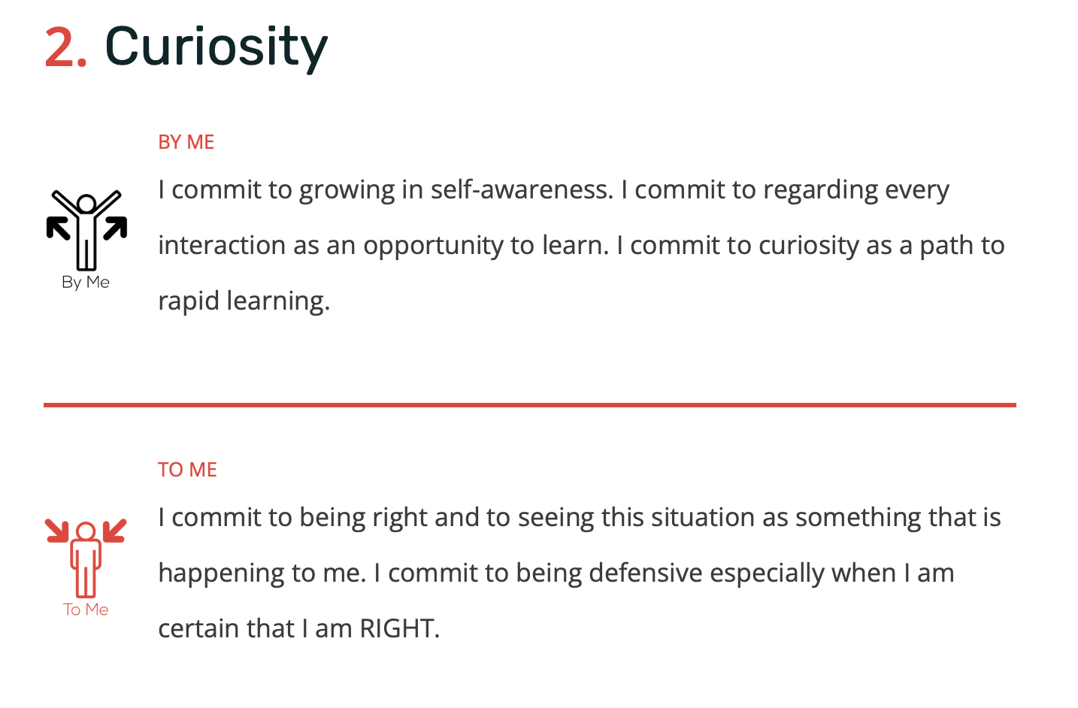
Curiosity vs Being Right | Conscious Leadership Group

Slide 58
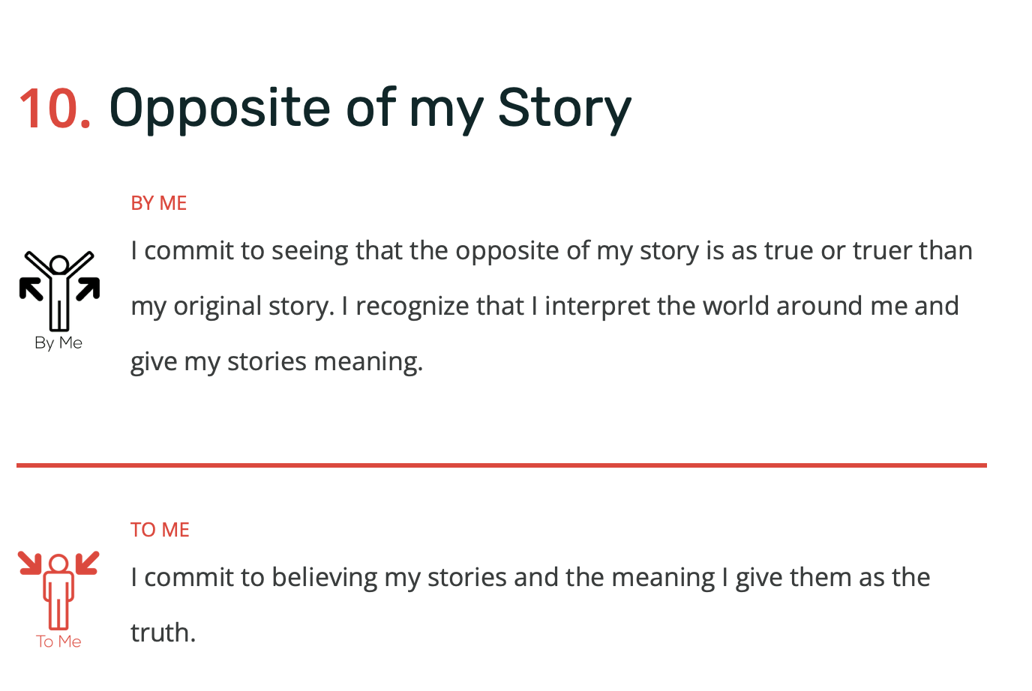

Slide 59

Opposite of My Story
Write down a situation or an issue where you were sure you were right; FEEL how right you were, argue about WHY you are right.
Now take a few deep breaths and then write down with conviction a rephrasing of the exact opposite, with equally strong conviction.
Now try for the next minute to hold both these truths, and see the rightness of both sides—you can hold them both in your mind together or go back and forth whichever you prefer
How was that for you?
Break into groups of 3 for discussion

Slide 60

What is your Commitment?
Take a minute to look over the handout—think about which commitment speaks to you the most right now.
Pick a partner—someone different from before.
Talk about what might make it hard for you to stick with this commitment, and what might help you stick with it.
COMMIT to work on this over the coming month.
COMMIT to helping your partner do the same.
Trade cell numbers if you don’t have them already so you can text/call each other over the next four weeks to be a commitment coach for your partner

Slide 61


